Slide 1

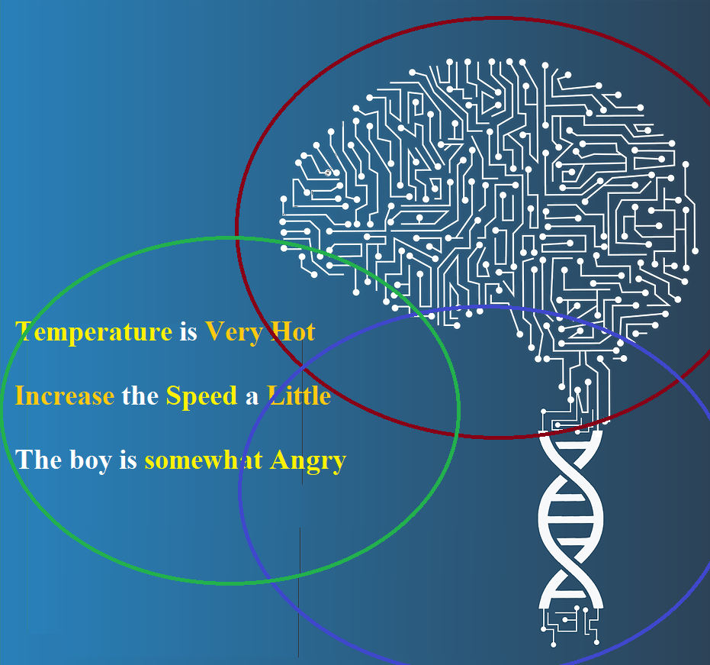

Introduction to Soft Computing
Talha Waheed
Department of Computer Science, UET, Lahore

Slide 2
(Revision) Two Main Approaches of AI
Symbolic
Classical AI: (“Good-Old-Fashioned AI”)
Intelligent behavior is the result of a Physical symbol system (➔)
Logical, top-down, designed behavior, knowledge-intensive
Sub-symbolic (Connectionist)
Modern AI: Biological and Social based
Intelligent behavior is the result of connection processing
Biological / Social, bottom-up, emergent behavior, learning-based

Slide 3
Sub-Symbolic vs Soft Computing
Two terms overlap and confused a lot, but they sit at different levels:
one is a paradigm of AI, the other is a toolbox of techniques.
Connectionist AI
It models intelligence through networks of simple interconnected artificial neurons. Knowledge isn’t stored as explicit rules or symbols; it’s distributed across the connection weights and learned from data.
Soft computing
A collection of methodologies that tolerate imprecision, uncertainty, and partial truth to achieve robust, low-cost solutions to problems that are hard to solve exactly.
Aspect | Sub-symbolic / connectionist | Soft computing
Nature | A paradigm or philosophy of AI | A family of techniques (set of toolbox) (connectionist is its subset)
Scope | Narrower; essentially neural networks | Broader; includes ANN, fuzzy logic, evolutionary computation/GAs, probabilistic methods, etc
Opposed to | Symbolic AI | Hard (precise, deterministic) computing
Inspiration | The brain’s structure | Human tolerance for imprecision + nature (evolution, swarms)
Handles uncertainty via | Learning distributed weights from data | Fuzzy sets, probability, approximate reasoning, heuristic search
Explicit knowledge | Not used (no symbols) | Fuzzy logic does use human-readable linguistic rules like warm, tall

Slide 4
Goals of Soft Computing
Well suited for real world problems where ideal solutions are not there.
To develop intelligent machines to provide solutions to real world problems, which are not modelled, or too difficult to model mathematically (exactly).
To exploit the tolerance for Approximation, Uncertainty, Imprecision, and Partial Truth to achieve close resemblance with biological systems and human like decision making

Slide 5
Hard Computing | Soft Computing
Accurate and Precise Analytical Model (is Mandatory) | Tolerance to Imprecision, Uncertainty, Approximation
Binary Logic (Rigid/Crisp/Precise). Requires Full Truth | Multi-valued Logic (Fuzzy). Works with Partial Truth
Exact Input Data / Exact Algorithms / Precise Output (Overly Exact Solution) | Imprecise and Ambiguous Input / Heuristic Algorithms / Approximate Output (Solution that’s Good Enough)
Mostly Sequential | Supports Parallelism
Deterministic (Total Order) | Non-Deterministic / Stochastic (Partial Order)
Program are to be written. (Rigid) | Programs initially written then Evolved (Adaptive)
Conventional Artificial Intelligence | Computational Human Intelligence
Numbers / Symbols (Symbol System Hypothesis) | Numbers / Words
Rational (Logical) Reasoning | Human Like (Approximate) Reasoning
Useful for Critical Systems | Useful for Routine Tasks (that are not Critical)
Real time Constraints | Artificial Constraints (Noise Imposed for Learning)
Suitable for Simple Problems, not Complex | Suitable for Complex Problems, not Simple
Large Computational Time | Less Computational Time due to approximation
Abstract Based (without context) | Empirical (Context) Based
Unique Algorithms for each problem | Hybrid/Plural

Slide 6
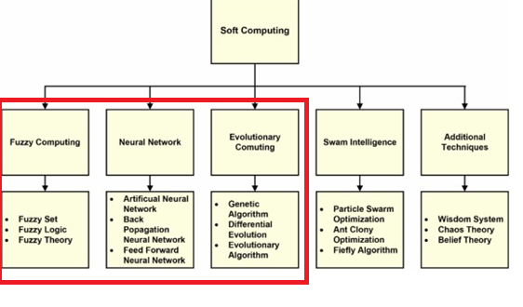
(Minimum) Components of Soft Computing
SC is an Umbrella term for all algorithms that deals with imprecision, uncertainty, partial truth, and approximation to achieve practicability, robustness and low solution cost.
However, its minimum components are
Fuzzy Logic: Multivalued Logic for treatment of imprecision and vagueness
Neural Networks: Neural Computers mimic certain processing capabilities of the human brain
Evolutionary Computing /Genetic Algorithms:
  used to mimic some of the processes observed in natural evolution and GAs are used to evolve programs to perform certain tasks.

Slide 7
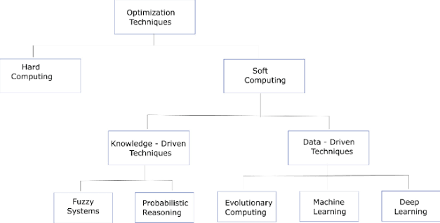
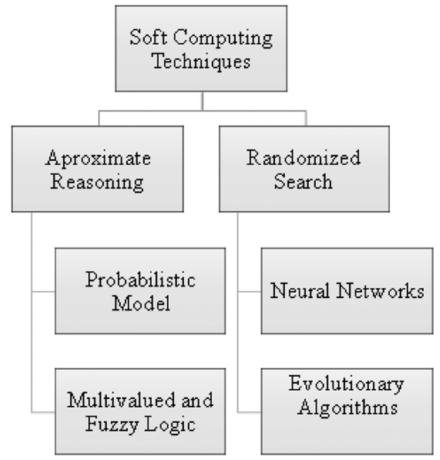
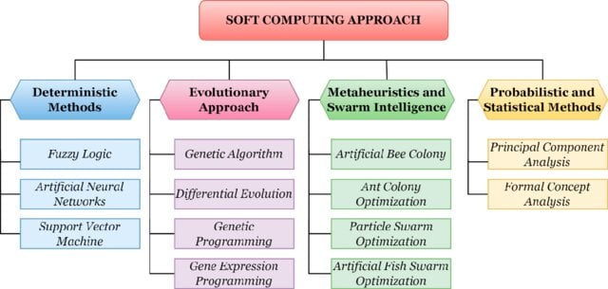
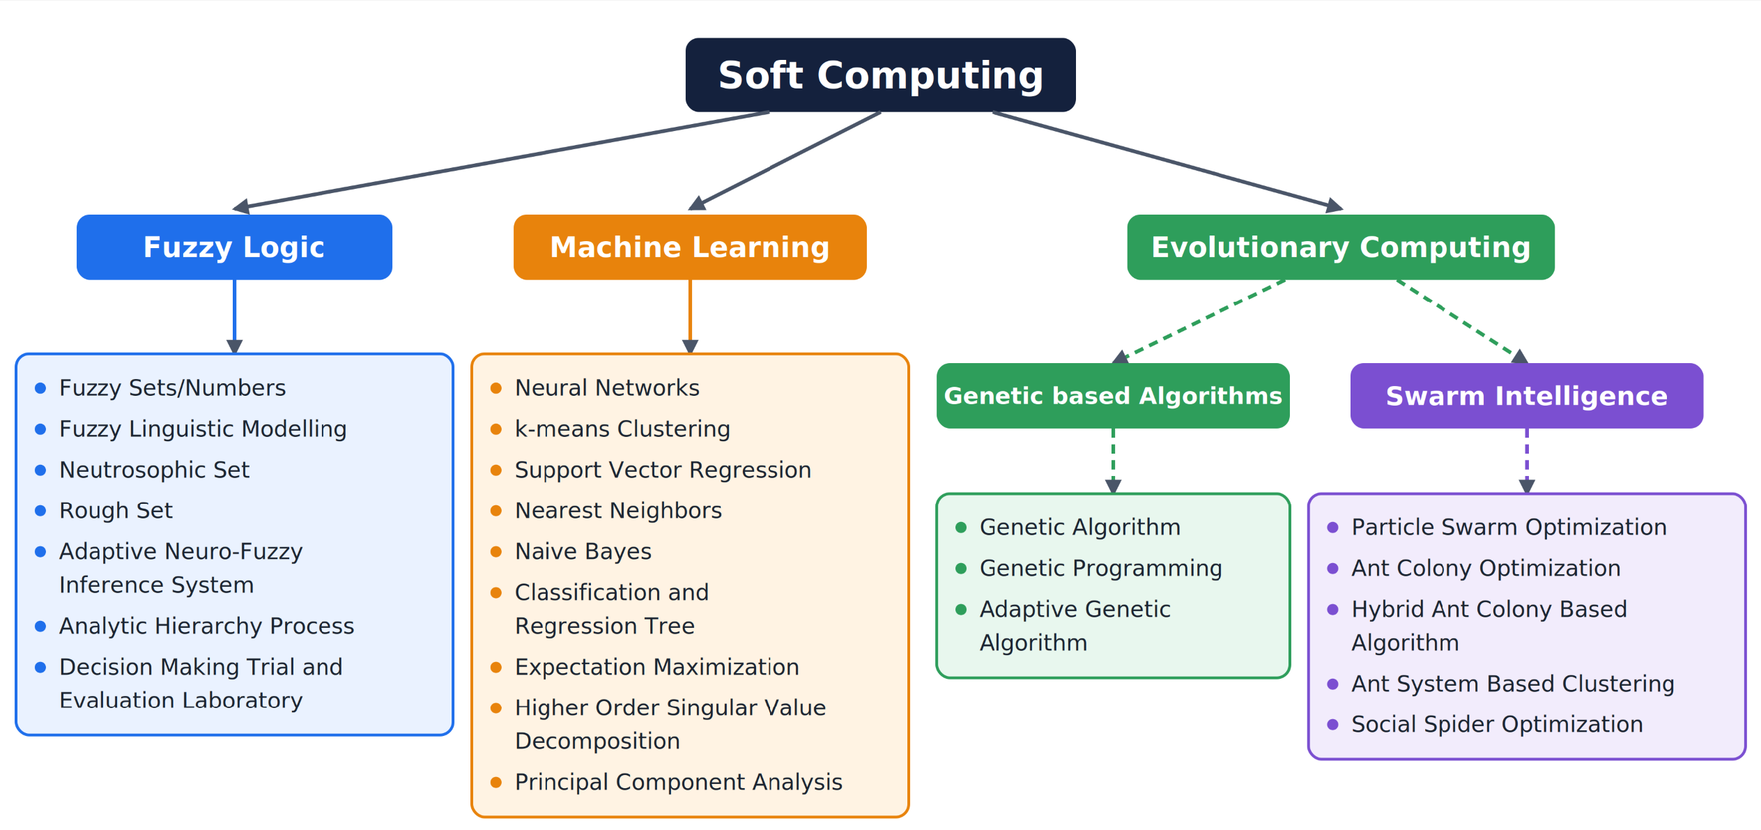
Different Classifications of Soft Computing Approaches

Slide 8
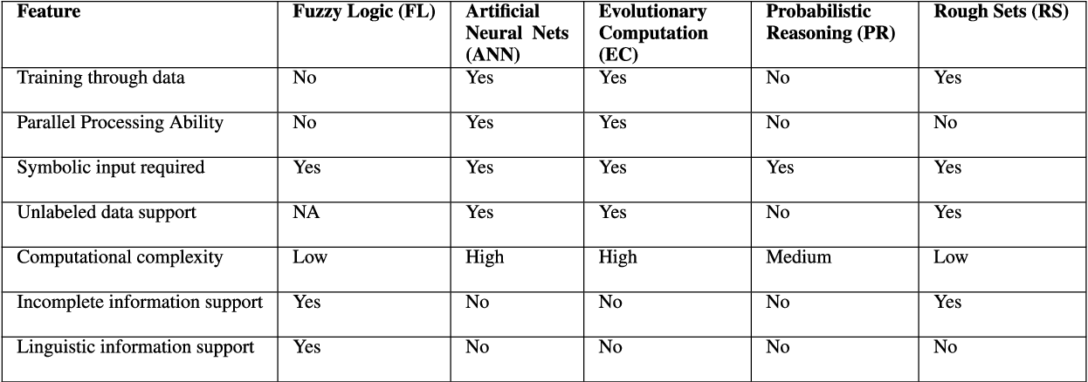
Feature wise Comparison of SC Approaches

Slide 9
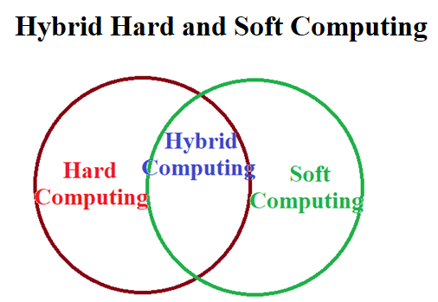
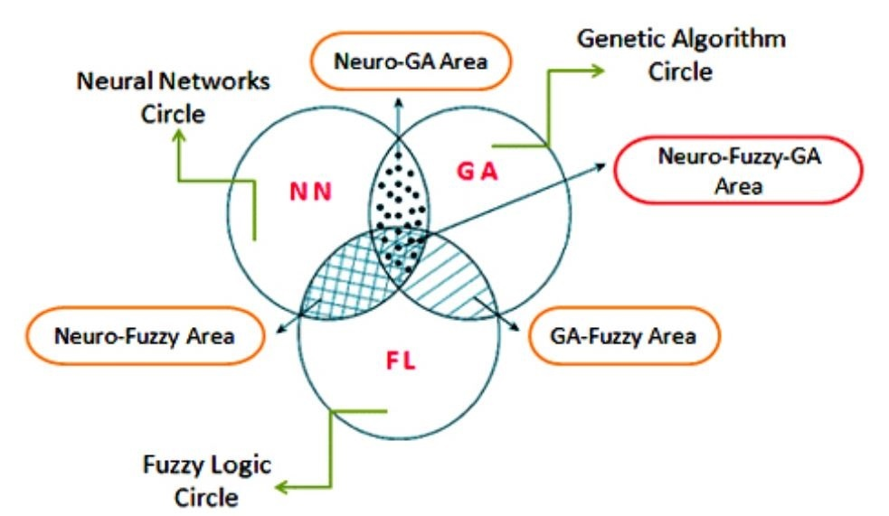
Hybrid Computing
Fuzzy logic for reasoning with vagueness using Natural Language,
artificial neural networks for learning from data,
genetic algorithms for evolving optimal solutions,
probabilistic reasoning for managing uncertainty.
Each of these is a complete field of study on its own — and each intersects the others in hybrid systems that represent the frontier of intelligent computing

Slide 10
Soft Computing Sub Areas - Brief History
Soft Computing (Zadeh 1981) =
Evolutionary Computing (Rechenberg 1960) +
Neural Network (McCulloch 1943 ) +
Fuzzy Logic (Zadeh 1965 )
Evolutionary Computing (Rechenberg 1960) =
Genetic Programming (Koza 1992) +
Evolution Strategies (Rechenberg 1965) +
Evolutionary programming (Fogel 1962) +
Genetic Algorithms (Holland 1970)

Slide 11
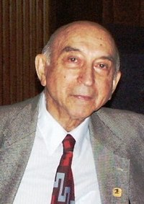
Lotfi Ali Askar Zadeh (1921-2017)
Born in Baku(Azerbaijan), mathematician, computer scientist, electrical engineer, AI researcher, and professor of CS at UC, Berkeley, (Received 24 Honorary Doctorate)
Zadeh is best known for proposing fuzzy mathematics,
  consisting of several fuzzy-related concepts: fuzzy sets, fuzzy logic, fuzzy algorithms, fuzzy semantics, fuzzy languages, fuzzy control, fuzzy systems, fuzzy probabilities, fuzzy events, and fuzzy information.
Zadeh's work has got at least ~300,000 citations, with the 1965 Fuzzy sets paper receiving at least 175k citations (Google Scholar).
Other Contributions: Z Transform, Computing with Words, General Theory of Uncertainty.

Slide 12

Fuzzy Logic - Some Application Areas
Home appliance
Washing machine, AC, Refrigerators, Heaters.
Robotics
  Bullet Trains, Emotional Pet robots.
Food appliances
  Rice cookers and Microwave.
Game playing
  Poker, checker etc.

Slide 13
Future Scope
Soft Computing can be extended to include other approaches like bio-informatics aspects.
Fuzzy system can be applied to the construction of more advanced intelligent industrial systems.
Soft computing is very effective when it’s applied to real world problems that are not able to solved by traditional hard computing.
Soft computing enables industrial to be innovative due to the characteristics of soft computing: tractability, low cost and high machine intelligent quotient.

Slide 14
Few Related Terms and Summary
Approximation: the model features are similar to the real ones, but not the same.
Uncertainty: not sure that features of the model are the same as that of the entity (belief).
Imprecision: the model features (quantities) are not same as that of the real ones, but close to them.
The guiding principle of soft computing is to exploit these tolerance to achieve tractability, robustness and low solution cost.
The role model for soft computing is the humans.

Slide 15
